Slide 1
Black & White Vibes Of Shoes
By: Linh Nguyen, Brittney Oeur, Jairo De La Mora

Slide 2
Main Focus of Program:
Logging in system
Shopping cart system
Adding items into the user’s cart.
Checkout system

Slide 3
Concept(s):
Scanner class
Random class
if/else statements
for/while loops
Creating objects and classes

Slide 4
Problems Encountered:
Calling a class from a different class.
Creating and setting up a class for objects.
Creating validation for user’s input.
EX: Asking the user’s for their card number after entering the items they want.

Slide 5
Logging in System:
Ask the user to enter their username.
Ask the user to enter their password.
If any of these is invalid, the system will inform the user that it is and will ask the user to re-enter their information again.

Slide 6
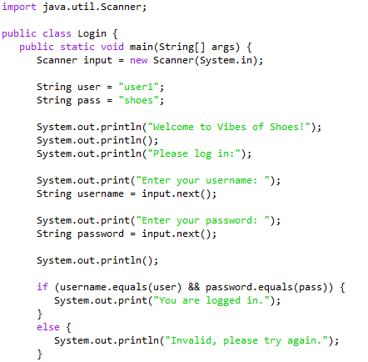
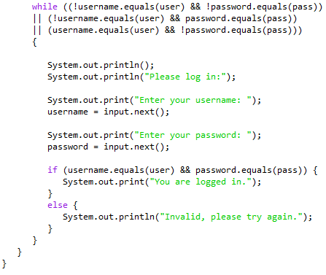
Logging in System Example Code:

Slide 7
Shopping Cart:
Offer a menu of options:
Add item(s) to your cart
Checkout your item(s)
Empty your cart
Exit the program

Slide 8
Add Items/Check-Out System:
The user will enter the name of the product, price of the product, and the their desire quantity of that product.
The program will then compute and print the total cost of their purchase.
It will also print out the amount of points the user will earn from their purchase. (The user will receive one point for every ten dollar they’ve spent).
Afterwards, the program will then ask the user for their card information for their payment method.
Once completed, the program will then give the user their tracking number.

Slide 9
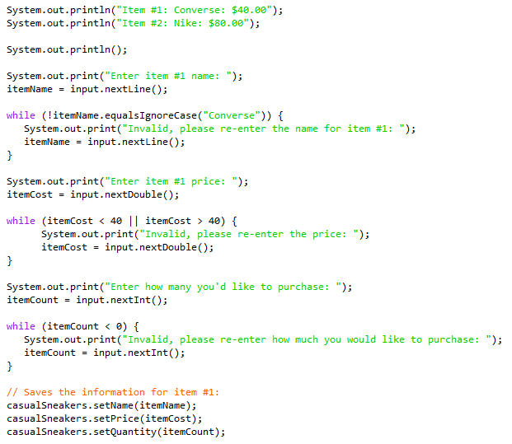
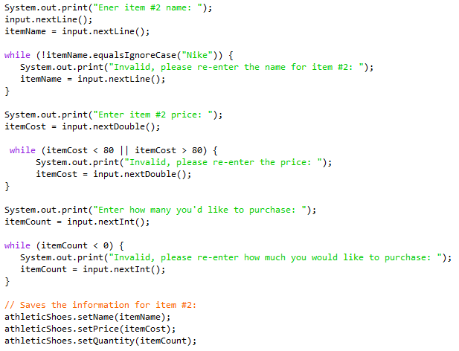
Checkout Example Code 1:

Slide 10
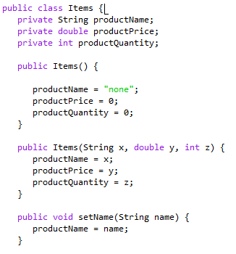
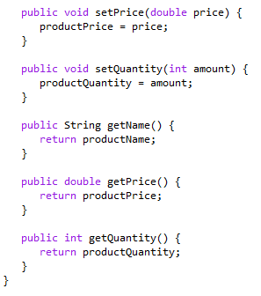
Checkout Example Code 2: (Items Class)
1
2

Slide 11
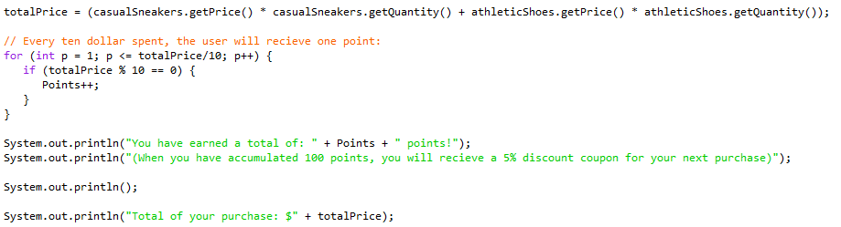
Checkout Example Code 3: Total calculation

Slide 12
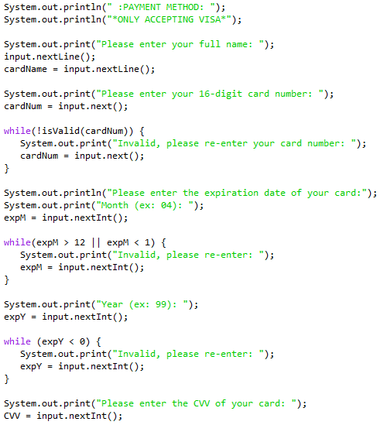
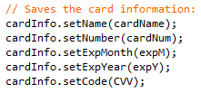
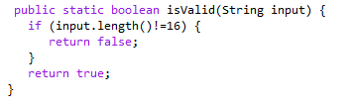
Checkout Example Code 4: User’s card info
*Separated method*

Slide 13
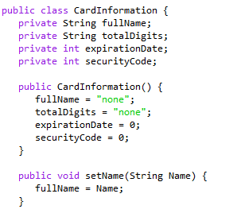
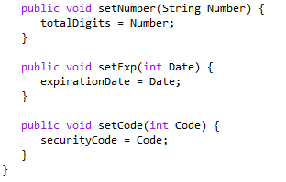
Checkout Example Code 5: (Card info Class)
1
2

Slide 14
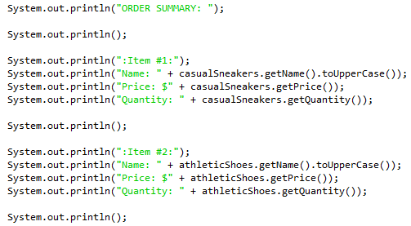
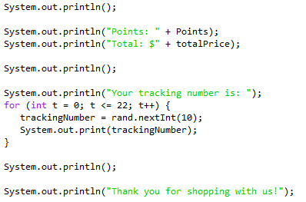
Checkout Example Code 6: Order summary
1
2

Slide 15
Empty the shopping cart & exit:
After successfully checkout, all the products will be empty in the shopping cart.
User can exit the app/website .

Slide 16
Conclusion/future development
This presentation is focus on how the logging in system and the checking out system work.
In the final version of project, we will try to implement:
Polish up the login system:
EX: The number attempts to login before they are blocked out for a certain amount of time.
Removing items from the cart.
(Maybe) allow the user to enter a coupon code that can only be used once.
Compile everything into one Java file:
Where the user is in the menu system and is able to choose where the want to go to.
EX: Adding item(s) into their cart and having the option to check-out afterwards.

